Slide 1
Sentiment Analysis For Market Research Based On Customer Feedback
Understanding Customer Sentiment to Drive Business Success

Slide 2
What is Sentiment Analysis?
Sentiment analysis is the process of using natural language processing and machine learning techniques to
analyze and
categorize opinions,
attitudes,
and emotions expressed in text data.
It helps to identify and quantify customer sentiment towards a product, service, or brand.

Slide 3
Importance of Sent. Analysis in Mkt. Research
Sentiment analysis is a powerful tool for market research as it provides insights into
customer attitudes,
preferences,
and behavior.
It helps to identify trends, patterns, and areas of improvement, which can be used to make informed business decisions.

Slide 4
SVM and Why SVM Model?
Support Vector Machines is a ML algorithm that can be used for classification and regression analysis.
We used this model for some reasons:-
Non-linear analysis: It can handle non-linear relationships between the input features and output labels
High accuracy: It known for their high accuracy in classification tasks, which makes them useful for predicting customer behavior based on feedback .
Robustness: It is robust to outliers and noise in the data, which is important for customer feedback analysis.
Flexibility: It can be used with a wide range of input data types, including text, audio, and image data.

Slide 5
Applications of SVM
Sentiment analysis: It is can analyze customer feedback to determine whether the sentiment expressed is positive, negative, or neutral.
Customer segmentation: It can segment customers based on their feedback and behaviorur, to identify different groups with distinct needs, preferences, and behaviors
Churn prediction: It can be used to predict which customers are at risk of leaving or churning, based on their feedback, behavior, and in businesses take proactive measures to retain those.
Product recommendation: It can be used to recommend products or services to customers based on their feedback and behavior, improving cross-selling and upselling opportunities.

Slide 6
Data Collection Methodology
Surveys: We can go through the surveys conducted by the governmental and non- governmental organization.
Experiments: we can conduct an experiment depend upon the data we need for analysis
Web scrapping: we can use web scrapping techniques for get the data.
Request to an API : we also request to an API for data collection.
If we have less data we can do following methods:
Synonym replace in sentence
Back translate
Add additional noise
Bi gram flip
Data plays a major role in our analysis if our data is strong then it will affect the accuracy and extrinsic evaluation of our model.

Slide 7
Methodology
Importing necessary libraries: We import the required libraries like pandas, NumPy, and scikit-learn to load and preprocess the dataset and perform sentiment analysis.
Loading the dataset: We load the dataset using pandas, which contains reviews of customers who have purchased Amazon Alexa products from Amazon.
Exploring the dataset: We display the first five rows of the dataset to get an overview of the data.
Selecting the required columns: We select only the required columns (verified_reviews and feedback) from the dataset.

Slide 8
Methodology
Checking for null values: We check if there are any null values in the dataset.
Dropping null values: We drop the rows with null values in the verified_reviews column.
Converting to string: We convert the data type of the verified_reviews column to string.
Checking feedback distribution: We check the distribution of feedback (positive/negative) in the dataset using a count plot.
Plotting review length distribution: We plot the distribution of review lengths for positive and negative feedback using histograms.

Slide 9
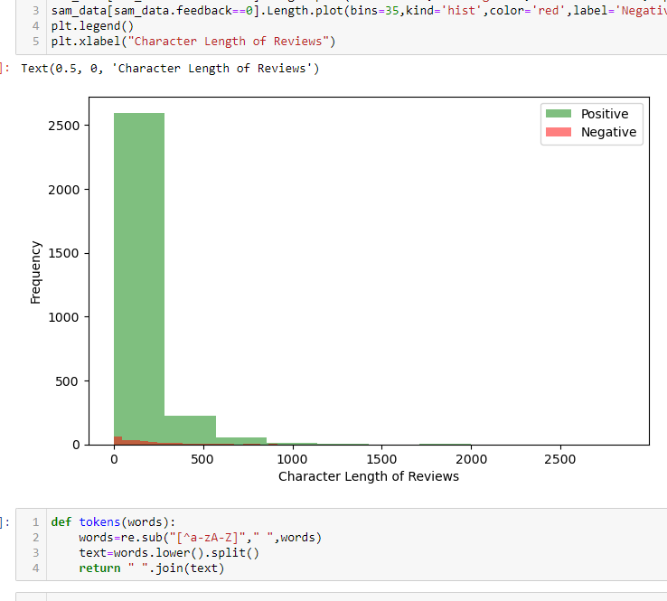
Methodology (Generated Histogram)

Slide 10
Methodology
Defining tokenization function: We define a function to tokenize the reviews by removing special characters and converting to lowercase.
Defining stop words: We define a list of stop words to remove from the reviews.
Defining function to remove stop words: We define a function to remove stop words from the tokenized reviews.
Defining function to remove numbers: We define a function to remove numbers from the tokenized reviews.
Defining function for lemmatization: We define a function to perform lemmatization on the tokenized reviews.

Slide 11
Methodology
Preprocessing the data: We preprocess the reviews by applying the functions defined in the previous cells.
Word cloud visualization: We visualize the most common words in positive and negative reviews using a word cloud.
Training a support vector machine (SVM) model: We train an SVM model on the preprocessed reviews and feedback labels.
Evaluating the model: We evaluate the accuracy of the SVM model and generate a classification report. We also visualize the report using a heatmap.

Slide 12
Results
The sentiment analysis model built on this dataset shows promising results with an overall accuracy of 94%.
The precision and recall scores for positive and negative classes are also high, indicating that the model is able to classify the reviews with good accuracy.
The word cloud generated for positive and negative reviews shows the most commonly occurring words in the respective categories.
Overall, the model built on this dataset can be used by companies to analyze customer reviews and improve their product accordingly.

Slide 13
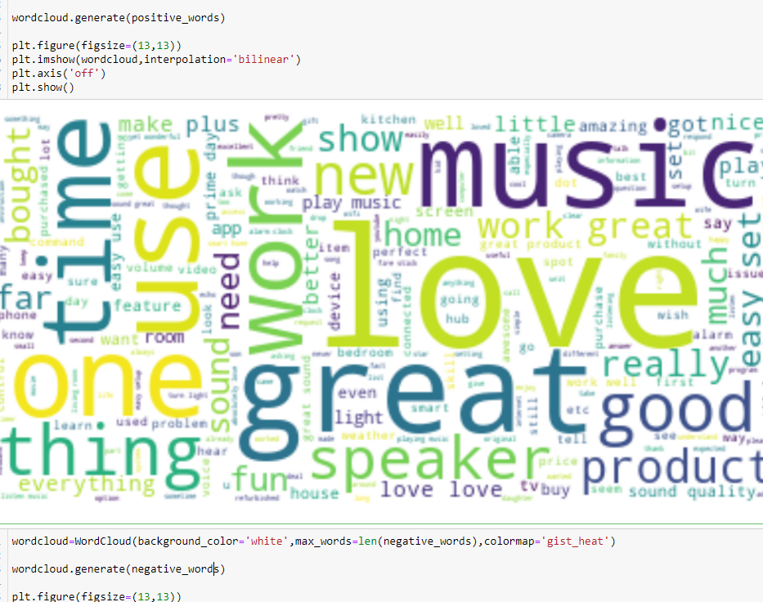
Results(Word cloud)
Positive sentiments
Positive reviews have words such as "love," "great," and "easy“.

Slide 14
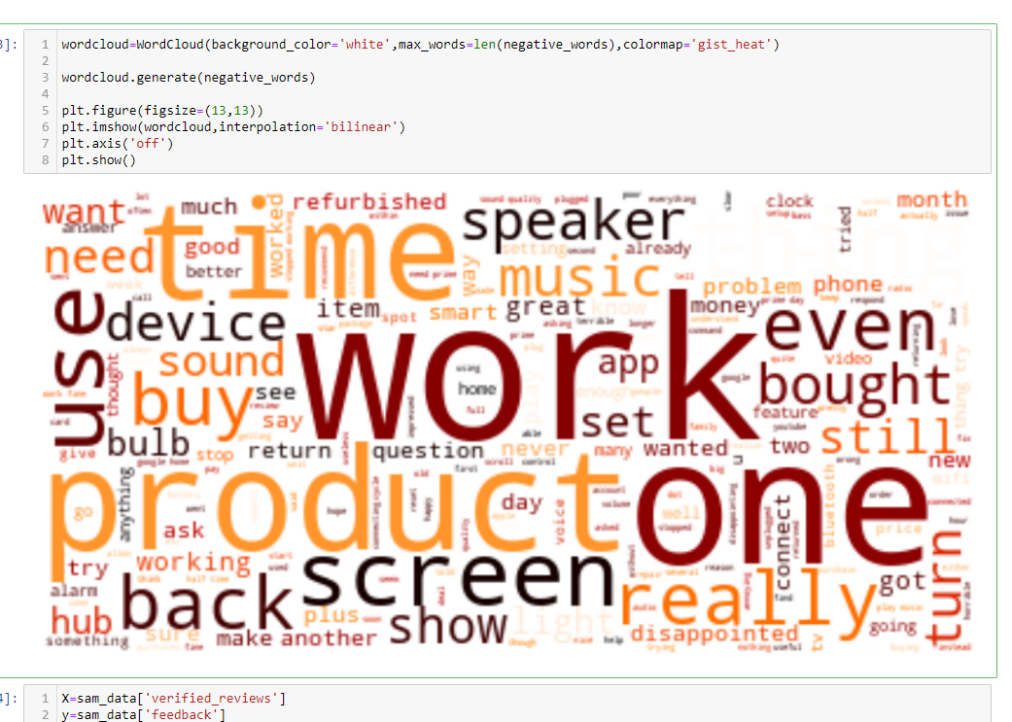
Results(Word cloud)
Negative sentiments
Negative reviews have words such as "disappointed,“ "problem," and "return."

Slide 15
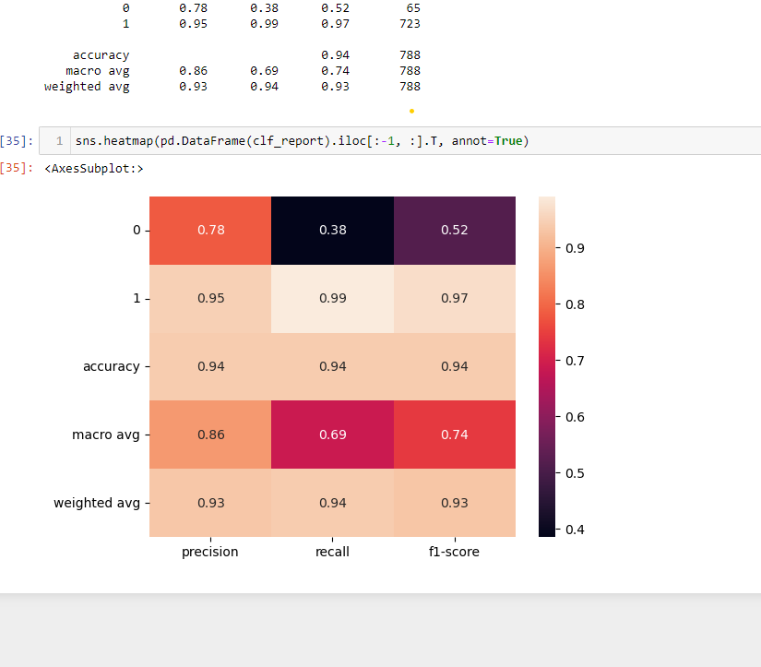
Results(Heatmap)
Classification report visualization
Heatmaps
to better visualize the volume of events within a dataset and assist in directing viewers towards areas on data visualizations that matter most.

Slide 16
Analysis Preferred to Validate Sent. Analysis
Human Annotation: Use humans to manually label a sample of text data and compare the results to the sentiment analysis output.
Precision, Recall, and F1 Score: Use metrics to evaluate the model's accuracy and performance.
Confusion Matrix: Use a table to evaluate the model's true positive, true negative, false positive, and false negative rates.
Cross-validation: Partition data into multiple sets to test the model's accuracy on new data.
A/B Testing: Compare the output of two different sentiment analysis models or techniques on the same data.

Slide 17
CONCLUSIONS
We performed sentiment analysis on Amazon Alexa product reviews using machine learning techniques.
The dataset consisted of 3150 reviews, out of which 2578 were positive and 572 were negative.
We performed data cleaning, text preprocessing, and feature engineering on the data to prepare it for machine learning models.
We used the LinearSVC model for sentiment analysis and achieved an accuracy of 95.4%.
The precision, recall, and F1 score for both classes were also high, indicating good performance of the model.
We created a wordcloud for both positive and negative reviews to get an insight into the frequently occurring words in both types of reviews.
Based on the wordclouds, we can infer that positive reviews have words such as "love," "great," and "easy," whereas negative reviews have words such as "disappointed," "problem," and "return."
The results of sentiment analysis can be useful for Amazon to make informed decisions about their product features and customer service.

Slide 18
References
https://www.techtarget.com/searchbusinessanalytics/definition/opinion-mining-sentiment-mining#:~:text=Sentiment%20analysis%2C%20also%20referred%20to,a%20product%2C%20service%20or%20idea.
https://www.researchgate.net/publication/322849665_Online_sentiment_analysis_in_marketing_research_a_review
https://www.revechat.com/blog/customer-sentiment-analysis/
https://www.keatext.ai/en/blog/glossary/what-is-sentiment-analysis/
https://www.questionpro.com/features/sentiment-analysis.html
https://towardsdatascience.com/five-practical-use-cases-of-customer-sentiment-analysis-for-nps-a3167ac2caaa
https://hiredigital.com/blog/sentiment-analysis-in-marketing-ideas-and-use-cases-for-businesses-of-all-type

Slide 19
THANK YOU

